Slide 1
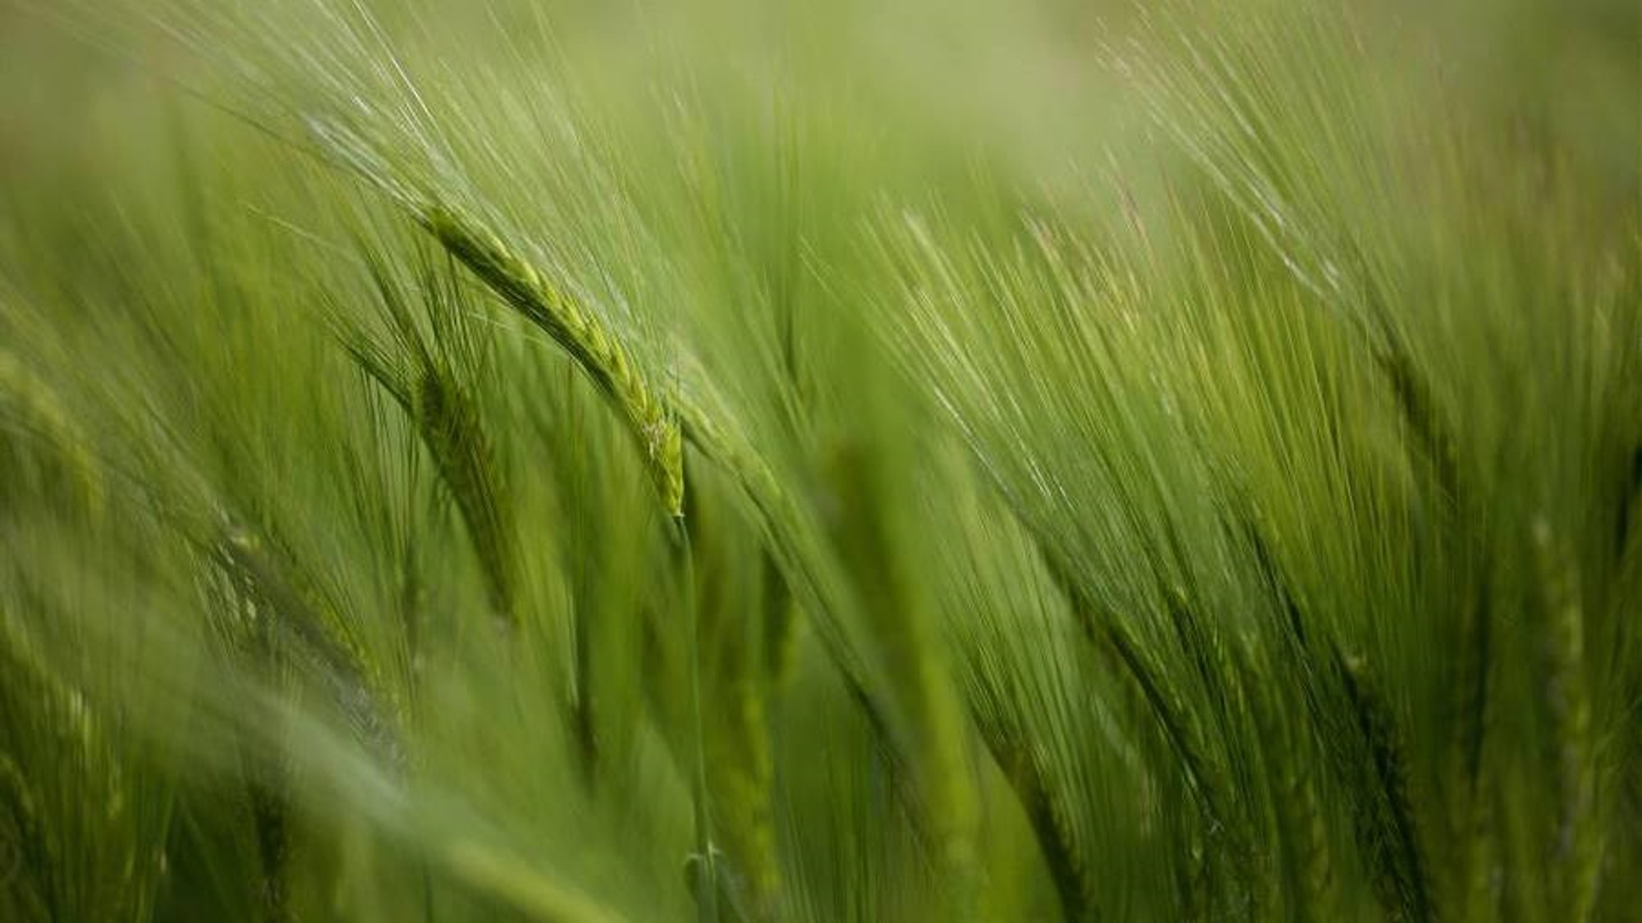

Predicting the Best Crop to Plant Based on Climatic Conditions
Final project: milestone 3 Name: Surena Nokham Course: DSC 680-T301: Applied Data Science Professor: Amirfarrokh Iranitalab Date: August 5, 2024

Slide 2

introduction
Objective:
Develop a predictive model to assist farmers in determining the most suitable crop to plant based on specific climates & soil conditions
Goals
Optimize crop yield
Enhance agricultural productivity
Improve decision-making
Increase profitability
Reduce waste
Improve resource utilization

Slide 3
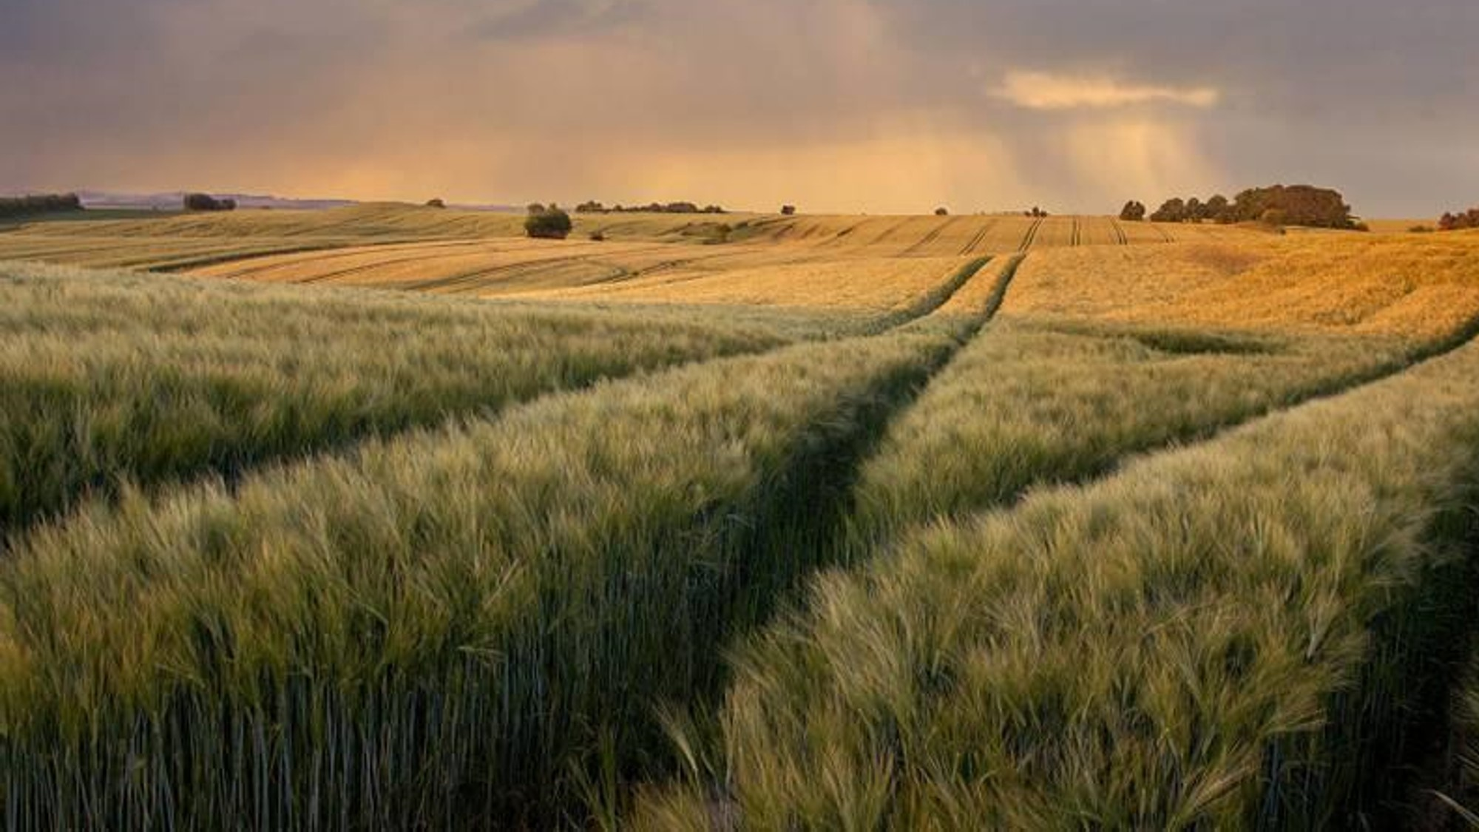
Business problem
Challenge: Farmers need accurate, data-driven recommendations for crop selection to optimize yield and resource utilization.
Solution: Leveraging machine learning to predict the best crop to plant based on local soil and climatic conditions.

Slide 4
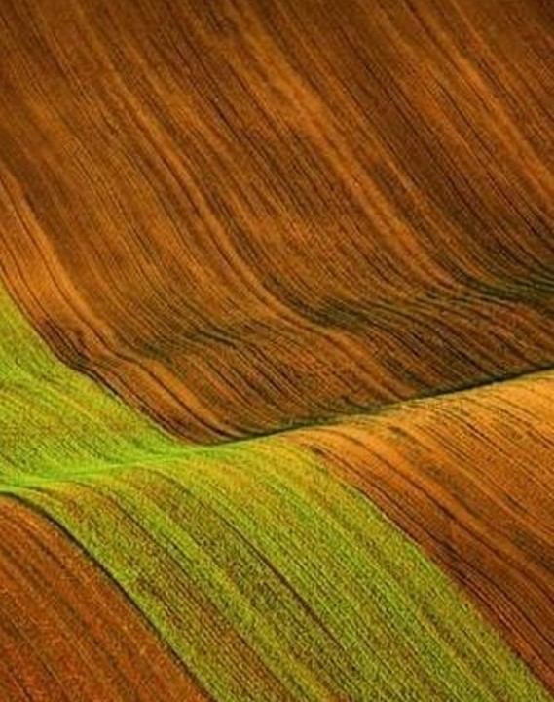
data source
Dataset: crop recommendation
Source: Kaggle
Features: Nitrogen (n), phosphorus (p), potassium (k), temperature, humidity, PH, RAINFALL
LINK: Crop Recommendation Dataset

Slide 5
Data preparation
Steps Taken:
Data Cleaning
Normalization
Handling Missing Values
Feature Engineering
Tools Used: Python, Pandas, NumPy

Slide 6
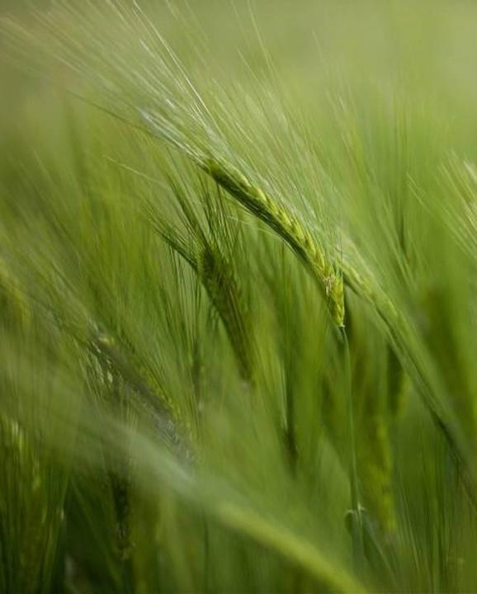
Exploratory data analysis (eda)
Objectives: Understand the distribution of features and relationships between them.
Tools Used:
Matplotlib, Seaborn

Slide 7
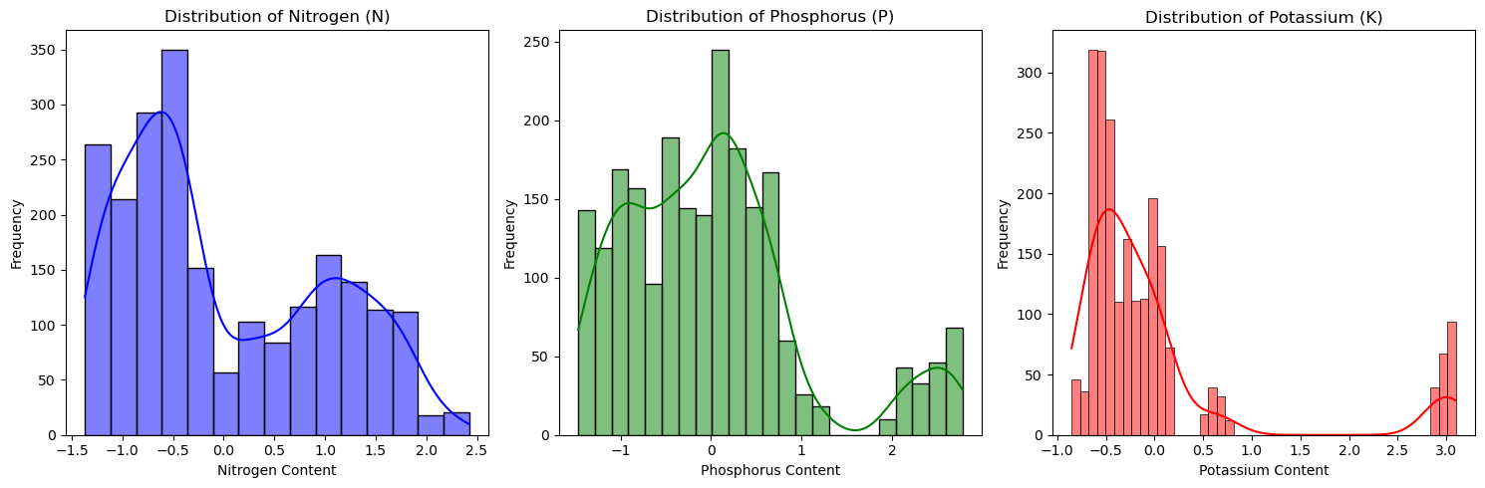
Distribution of n, p, k in soil
Histograms showing variability & concentration of nutrients.
Insight: Nitrogen & Phosphorus are right-skewed, potassium has 2 peaks

Slide 8
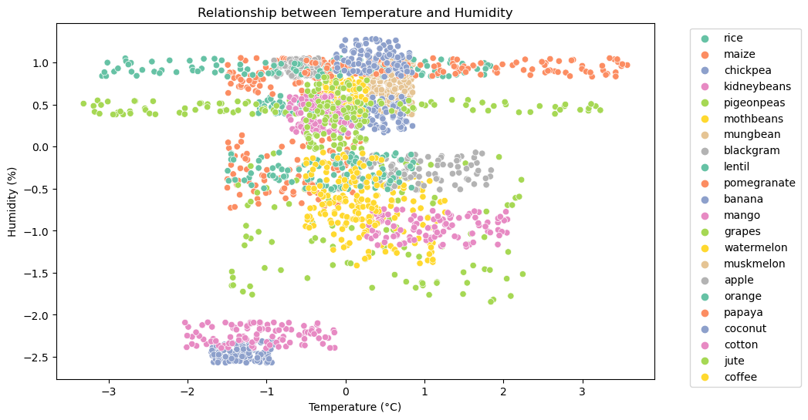
Temperature vs. humidity
Scatter plot showing crop preferences for specific conditions.
Insight: Inverse relationship, crops cluster based on preferences

Slide 9
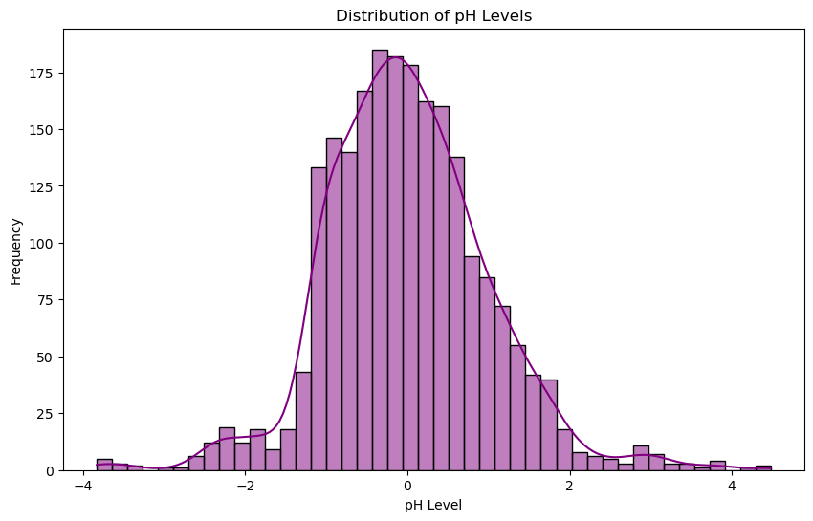
Distribution of ph levels
Histogram indicating soil acidity/alkalinity range.
Insight: Slight right skew, most soils are slightly acidic to neutral

Slide 10
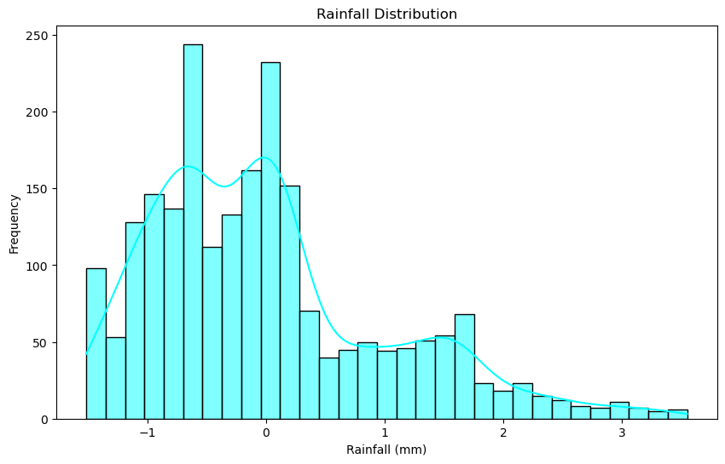
Rainfall distribution
Histogram showing precipitation variability.
Insight: Left-skewed, most samples have moderate rainfall

Slide 11
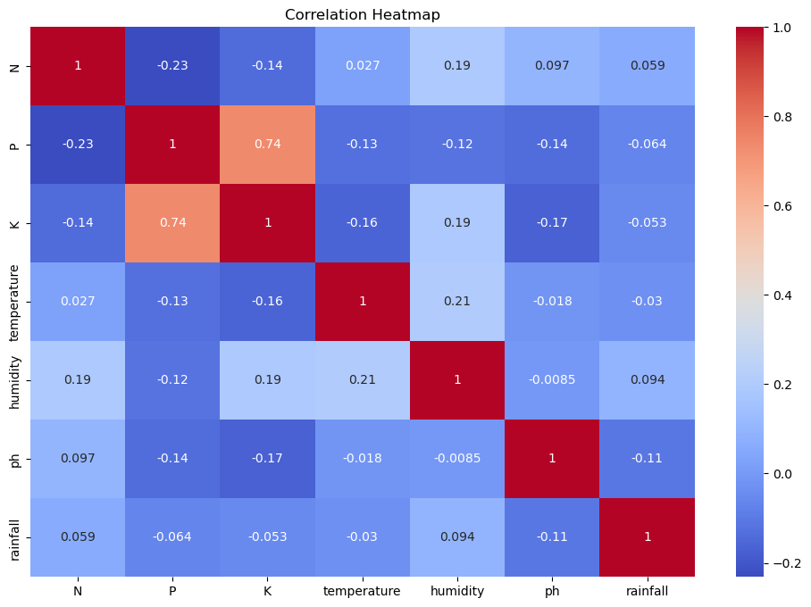
Correlation heatmap
Visualizing relationships between features.
Insight: Strong negative correlation between temperature & humidity; low correlation among nutrients

Slide 12
Model selection
Models Evaluated:
Decision Trees, Random Forests, Gradient Boosting Machines (GBM), Neural Networks
Selected Model:
Random Forest Classifier
Reason:
High performance & robustness in initial testing
Achieved impressive accuracy of 99.3%
Balanced performance across all classes

Slide 13
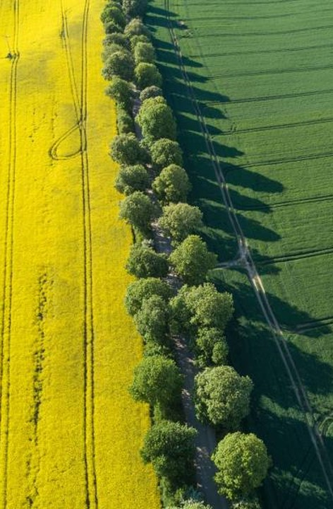
Model training and evaluation
Training: 80% of the dataset
Testing: 20% of the dataset
Metrics Used:
Precision, Recall, F1-score – balanced across all crop classes
Results:
Random Forest achieved 99.3% accuracy

Slide 14

Final model insights
The model provides near-perfect crop recommendations with an accuracy of 99.3%.
Balanced performance across all metrics ensures reliable predictions.
Highly reliable tool for farmers, enhancing decision-making and profitability."

Slide 15
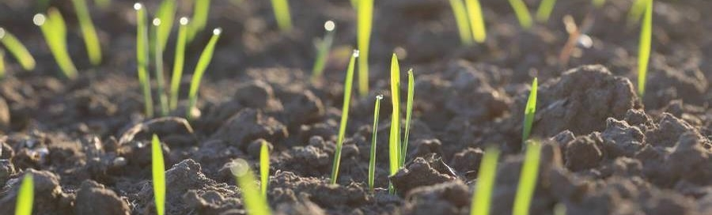
Ethical considerations
Data Privacy:
Data was anonymized and cleaned, but ongoing compliance with data protection regulations is essential
Bias Avoidance:
Avoiding biases that favor certain crops or regions
Accessibility:
Ensuring the tool is user-friendly for farmers with varying technical expertise

Slide 16
challenges
Data Accuracy:
Ensuring datasets are up-to-date and representative
Generalization:
Avoiding overfitting to ensure the model performs well across different regions
User Interface:
Developing a user-friendly interface for farmers

Slide 17

Future uses/applications
Expand Crop Range:
Include more crops & additional climatic factors
Real-Time Data Integration:
Use real-time weather data for more accurate recommendations
Mobile Applications:
Develop mobile apps for wider accessibility

Slide 18
recommendations
Regular Updates:
Update the dataset regularly for improved accuracy
Field Trials:
Validate model predictions through field trials & gather feedback
Collaborate with Experts:
Continuously refine the model with input from agricultural experts

Slide 19
Questions & answers
1. How accurate is the model in predicting the most suitable crop?
Answer: The Random Forest model achieved an outstanding accuracy of 99.3%, indicating its effectiveness in predicting the most suitable crop based on climatic & soil conditions
2. What are the main factors that influence the crop recommendations?
Answer: The main factors influencing crop recommendations are nitrogen, phosphorous, potassium levels, temperature, humidity, pH level, and rainfall
3. How does the model handle missing or inaccurate input data?
Answer: The model was training on a cleaned dataset where missing values were handled. In practice, data validation techniques can be implemented to handle missing or inaccurate inputs before making predictions
4. Can the model be adapted to include more crops in the future?
Answer: Yes, the model can be retrained with an expanded dataset that includes more crops & additional features to improve its versatility and accuracy
5. How frequently should the dataset be updated to maintain the model’s accuracy?
Answer: It is recommended to update the dataset at least annually or biannually to incorporate new data & ensure the model remains accurate and relevant

Slide 20
Questions & answers
6. What measures are in place to ensure data privacy and security?
Answer: Data privacy is ensured by anonymizing collected data & adhering to data protection regulations. Secure storage & access controls are implemented to protect the data
7. How does the tool account for unexpected weather events or pest infestations?
Answer: The current model does not account for either. Future iterations could integrate real-time weather data & pest forecasts to enhance its predictive capabilities
8. What kind of feedback have you received from farmers who have used the tool?
Answer: Initial feedback from farmers indicates that the tool is user-friendly & provides valuable crop recommendations. Field trials are planned to gather more comprehensive feedback
9. Are there any plans to integrate the tool with other agricultural technologies?
Answer: Yes, loT devices are real-time data collection and mobile apps for wider accessibility
10. How scalable is the tool for use in different regions with varying climatic conditions?
Answer: The tool is designed to be scalable & can be adapted to different regions by retraining the model with localized data to account for varying climatic conditions

Slide 21
conclusion
Summary:
The predictive model helps farmers make informed decisions, optimizing crop yield & resource utilization
Impact:
Enhances agricultural productivity & profitability, benefiting farmers and the agriculture industry

